Slide 1
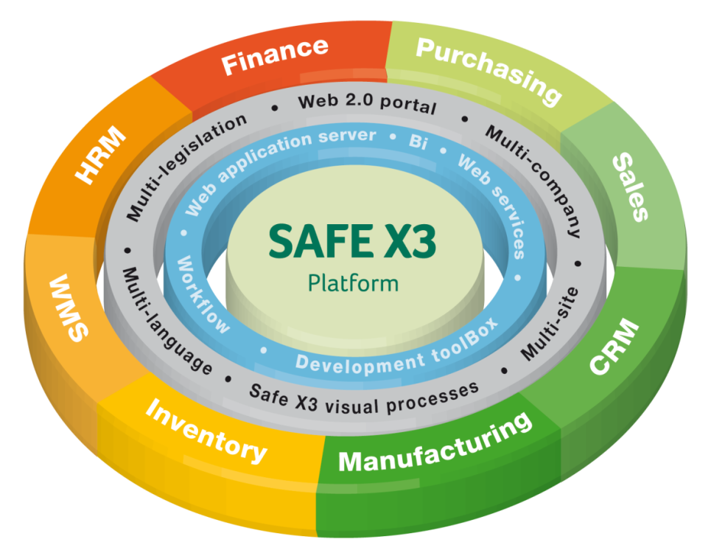
Mid Market and Enterprise Solution
  All in One Enterprise Management Solution
  New Level of Power and Flexibility
  Functionally Advanced, yet Simple and Cost Effective
Key Features
  Real Time and Fully Web Compatible
  Increase Business Insight
  Streamline Operations
  Enhance Collaboration
  Reduce Costs

Slide 2





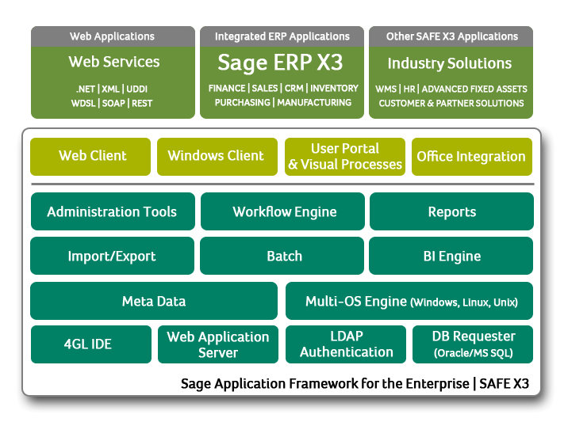







Advanced Technology Design for the Enterprise
Web-Native
SOA / Metadata-Driven
Integrated, common tools supporting all
enterprise applications
Comprehensive toolset for administrators and
developers

Slide 3
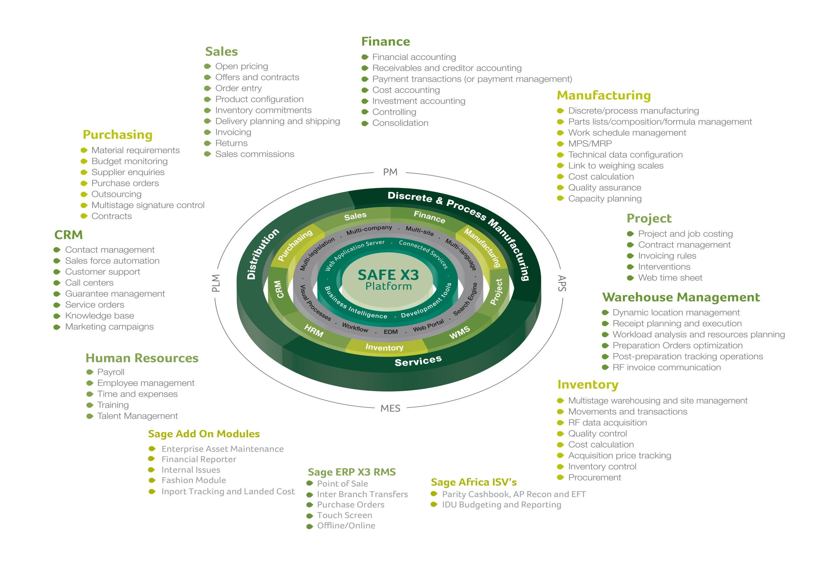
A Complete and an Extensive Business Solution: Sage ERP X3
Notes:
Sage ERP X3 is based on the SAFE X3 platform, based on an functional architecture Multi-legislations, multi-companies and multi-sites, and organized around a large scope of functionalities with finance, purchasing, sales, CRM, manufacturing, inventory WMS, HR. This scope has been completed with ISv, with dedicated Industries Solution built by our partner.
We are pleased to announce the Partners program’s launch which will be presented in a later stage.

Slide 4

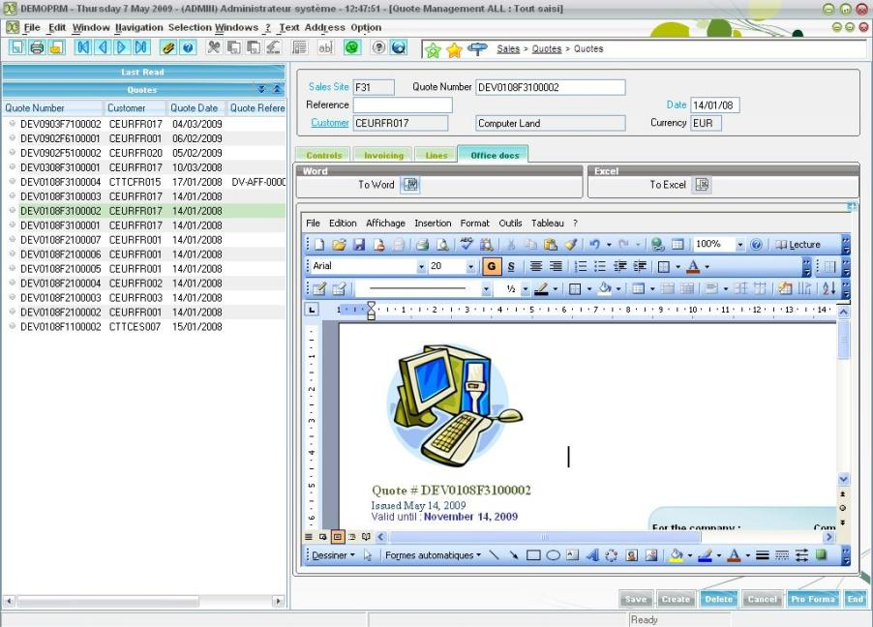

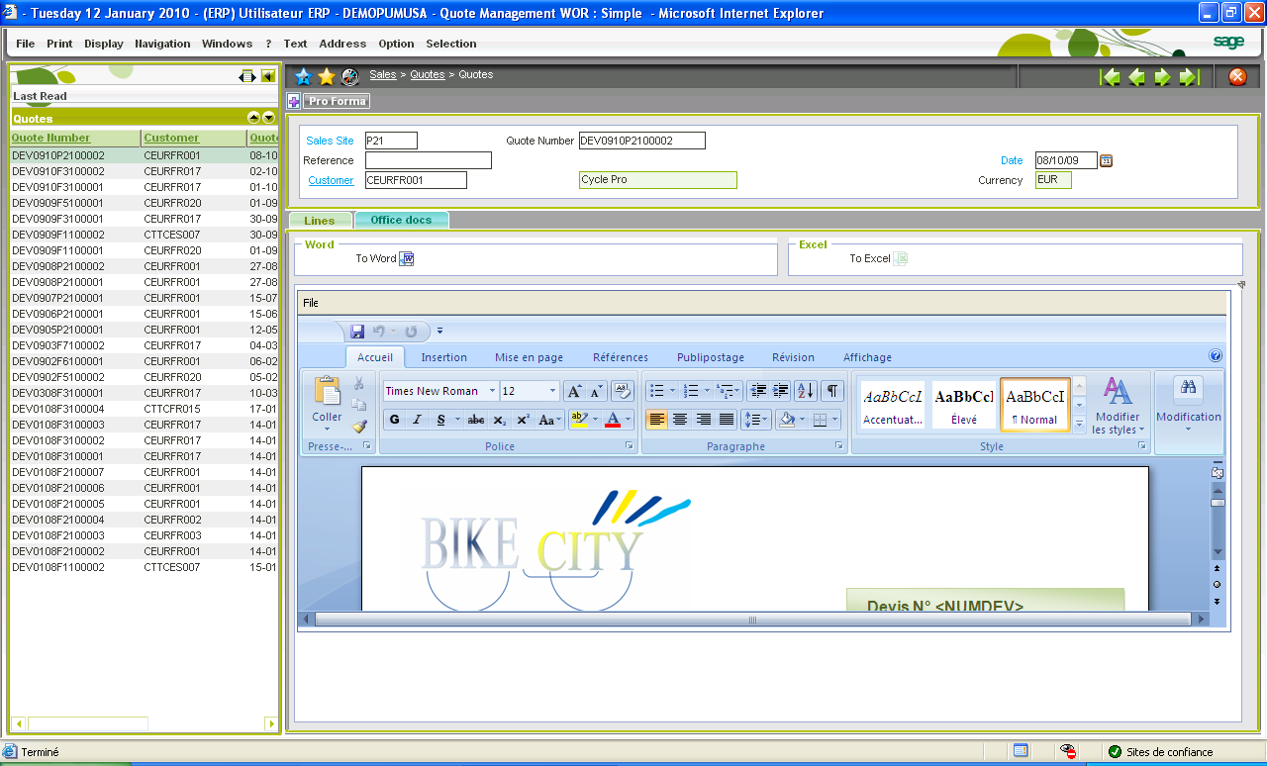
Familiar Usability In Context
NEW
Microsoft Office
documents
directly created
or modified in context
Securely saved
in the ERP DB
Information & Data
together
2010
Notes:
How much information do you keep in your office documents? A majority, right?
Are they attached to the process you’re into at every moment? No
Are they stored on your laptop and backed up securely? Raise your hand
Are they fueled with up-to-date data coming from your financials?
Example: place a proposal to a customer and sharing consistent documents for your management meetings
We’ve added Office 2007 integration to V6 and improved it from V5!
But who better than Microsoft can talk to this? Well I have the pleasure to welcome…

Slide 5





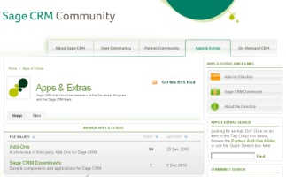


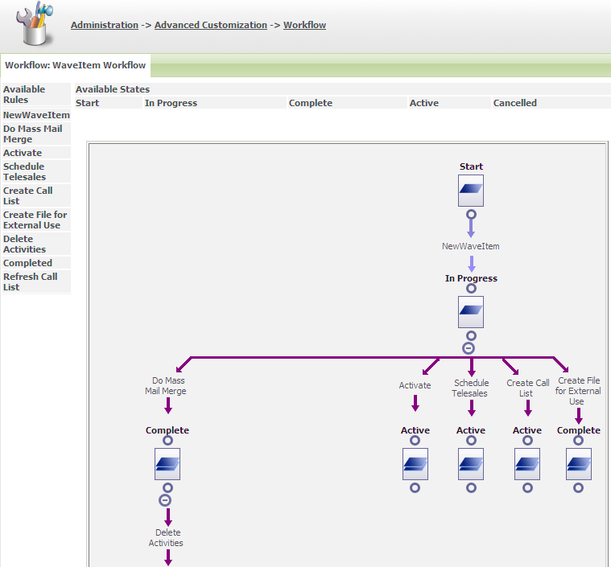
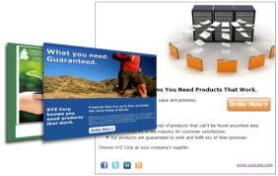





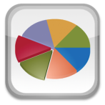
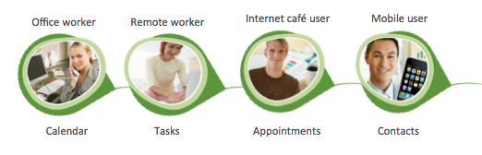
Sage CRM v7.1
Sales Force, Marketing, Customer Care
Fast, flexible deployment
On-Premise, hosted and Cloud deployment options
Powerful MS Exchange integration with easy point-and-click deployment
Sage CRM
On-premise
SageCRM.com
On-demand
Sage CRM
Cloud-deployable
Fits the way you work
24hr access to up-to-date communications, calendar and contacts regardless of location
Integrates with Twitter and LinkedIn
Access to global marketplace of add-ons at www.sagecrm.com
Accelerates marketing success
Simple 3-step wizard to execute e-marketing campaigns quickly and easily with a choice of over 90 professional templates
Ready-made marketing campaign workflow out-of-the-box
Simple campaign cloning to re-produce winning campaigns
Boosts business productivity
Roles-based interactive dashboards out-of-the-box
Fully configurable so you can personalise to your needs
Enhanced graphical report charts for at-a-glance insight on business performance
Notes:
Sage CRM v7.1 builds on our core value proposition by delivering the functionality our customers need to work smarter and succeed in today’s competitive marketplace

Slide 6




Beyond ROI: Implement Sage ERP X3
Easy to Use
  Visual Processes
  Portal
Fast to Deploy
  Web Based
  Cloud Ready and Connected Services
Cost Effective
  Implementation Choice and Handover
SAGE
YOU
SOLUTION
COMMITMENTS
Customer satisfaction
Project effectiveness
Global Quality
EXPECTATIONS
Requirements
Deadlines
Constraints
Budget
COMPONENTS
Controlled
Permanent Scalable
ECE
Sage Business Solutions are a great Company to do business with

